Slide 1
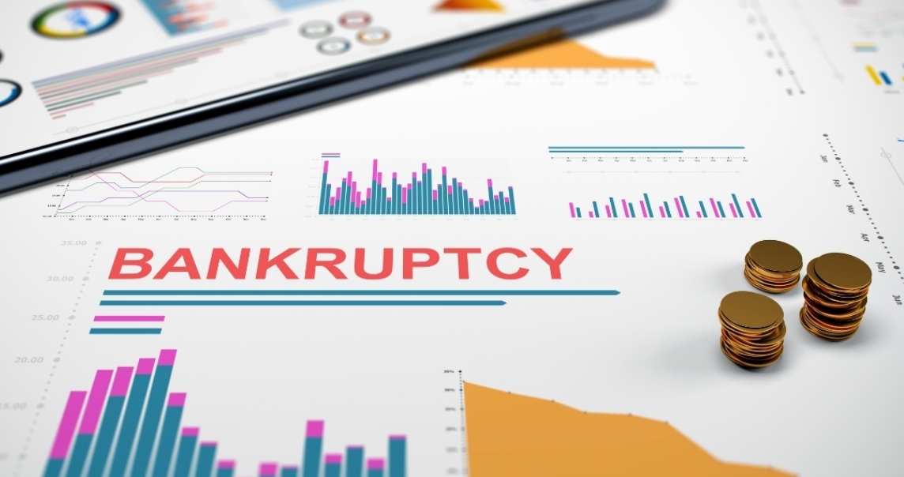
Predicting Company Bankruptcies
Machine Learning–Based Risk Prediction System
Name: Sayantani Guha
Domain: Data Science & Artificial Intelligence
Organization: Spinnaker Analytics
Submission Date: February 2026

Slide 2

CONTENTS
Introduction
Problem Statement
Project Objectives
Dataset Overview
Target Variable Analysis
Exploratory Data Analysis (EDA)
Feature Selection
Data Preprocessing
Machine Learning Models
Model Evaluation Metrics
Model Comparison
Final Model Selection
Conclusion
Business Impact

Slide 3
INTRODUCTION
Predicting company bankruptcies is a critical task for financial institutions, investors, and risk management teams. Bankruptcy events can lead to significant financial losses and impact overall market stability. Traditional prediction methods often fail to capture complex relationships among financial indicators and are not effective in early risk detection.
This project focuses on building a machine learning–based classification system to predict whether a company is likely to go bankrupt using historical financial data. By analyzing key financial ratios and performance indicators, the model identifies early warning signals of financial distress. The proposed solution aims to improve risk assessment, support informed decision-making, and help organizations take proactive measures to minimize potential losses.

Slide 4

Problem Statement
Company bankruptcy poses a serious risk to financial institutions, investors, and the overall economy. Traditional bankruptcy prediction methods rely on manual analysis and rule-based systems, which are often time-consuming and ineffective in handling large volumes of financial data and complex relationships among financial indicators. Due to the lack of timely and accurate prediction mechanisms, organizations often fail to identify early warning signs of financial distress.
The objective of this project is to develop a machine learning–based system that can accurately predict whether a company is likely to go bankrupt using historical financial ratios and performance indicators. By leveraging data-driven techniques, the proposed solution aims to improve early risk detection, support better financial decision-making, and reduce potential economic losses.

Slide 5
Project Objectives
To analyze financial indicators that influence company bankruptcy.
To perform exploratory data analysis to identify patterns and trends in the data.
To handle class imbalance and preprocess the dataset for accurate modeling.
To build and compare multiple machine learning models for bankruptcy prediction.
To select the best-performing model based on appropriate evaluation metrics.

Slide 6

Dataset Overview
The dataset consists of financial ratios and performance indicators of companies.
Each record represents a company’s financial condition for a specific period.
The target variable indicates whether a company is bankrupt or non-bankrupt.
The dataset is used for a binary classification problem to predict bankruptcy risk.

Slide 7
Target Variable Analysis
The target variable represents the bankruptcy status of a company.
Value 1 indicates a bankrupt company, while 0 indicates a non-bankrupt company.
The dataset is highly imbalanced, with significantly fewer bankrupt companies.
Due to class imbalance, evaluation metrics such as Precision, Recall, and F1-score are prioritized over accuracy.

Slide 8

Exploratory Data Analysis (EDA)
Exploratory Data Analysis was performed to statistically and visually examine the underlying structure of the dataset prior to model development. Univariate analysis was used to study the distribution, central tendency, and spread of individual financial features, while box plots were employed to detect outliers and extreme values. Bivariate and multivariate analyses, including correlation matrices and heatmaps, were conducted to identify relationships and multicollinearity among variables.
EDA also helped assess class imbalance in the target variable and understand how financial indicators differ between bankrupt and non-bankrupt companies. These insights guided feature selection, dimensionality reduction, and preprocessing decisions, ultimately improving model stability, interpretability, and predictive performance.

Slide 9

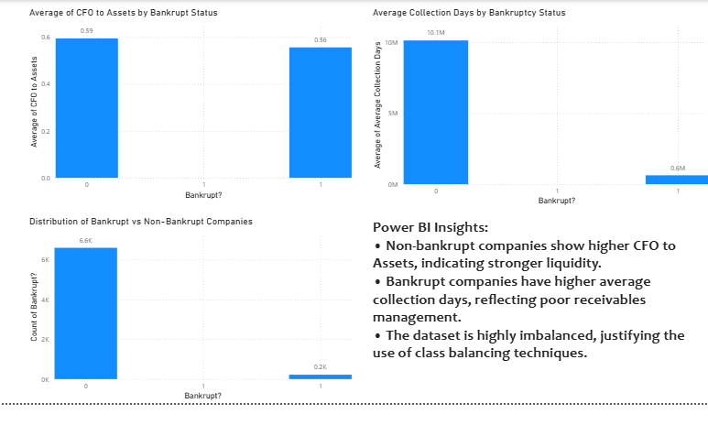
Power BI Dashboard & Key Insights
• Power BI was used to visually analyze key financial indicators related to company bankruptcy.
• Non-bankrupt companies show higher CFO to Assets, indicating stronger liquidity and cash flow stability.
• Bankrupt companies exhibit higher average collection days, reflecting inefficient receivables management.
• The distribution of bankrupt vs non-bankrupt firms is highly imbalanced, justifying the use of class balancing and ensemble machine learning models.

Slide 10

Feature Selection
Feature selection was conducted to reduce dimensionality and improve model generalization by retaining only the most informative financial variables. Statistical correlation analysis was applied to quantify the strength of association between each feature and the target variable, allowing the elimination of weakly correlated and redundant features. This process helped mitigate multicollinearity, reduce model complexity, and prevent overfitting. The selected subset of features ensured efficient learning and improved interpretability while maintaining strong predictive performance.

Slide 11
Data Preprocessing
Data preprocessing was carried out to prepare the dataset for machine learning modeling. The data was split into training and testing sets using stratified sampling to maintain class distribution. Feature scaling was applied to standardize financial variables, ensuring consistent model performance. Class imbalance was addressed to reduce prediction bias and improve the reliability of bankruptcy classification.
Cleaned and prepared the dataset for machine learning modeling.
Split the data into training and testing sets using stratified sampling to preserve class distribution.
Applied feature scaling to standardize financial indicators and ensure uniform contribution of features.
Addressed class imbalance to prevent bias toward the majority class.
Ensured data consistency and quality to improve model stability and generalization.

Slide 12

Machine Learning Models
Multiple machine learning classification models were implemented to predict company bankruptcy. These included Logistic Regression, Decision Tree, Random Forest, Gradient Boosting, and XGBoost. Each model was trained and evaluated using the same dataset to ensure fair comparison. Using multiple models helped identify the most accurate and robust approach for bankruptcy prediction.

Slide 13
Model Evaluation Metrics
Model performance was assessed using multiple evaluation metrics to account for the imbalanced nature of the bankruptcy dataset. Accuracy was not solely relied upon, as it can be misleading when the majority class dominates predictions. Precision and Recall were used to evaluate the model’s ability to correctly identify bankrupt companies while minimizing false positives and false negatives. The F1-score, as the harmonic mean of Precision and Recall, provided a balanced measure of classification performance. Confusion matrices were analyzed to obtain detailed insights into true positives, false positives, true negatives, and false negatives, ensuring a comprehensive evaluation of model effectiveness.

Slide 14
Model Comparison
Multiple machine learning models were compared to identify the most effective approach for bankruptcy prediction. All models were trained and evaluated on the same preprocessed dataset using consistent evaluation metrics to ensure a fair comparison. Performance was assessed primarily using Precision, Recall, and F1-score due to class imbalance. Ensemble-based models demonstrated superior performance by effectively capturing complex non-linear relationships and reducing variance and bias. The comparison results highlighted the strengths and limitations of each model, enabling informed selection of the final predictive model.

Slide 15

Conclusion
This project demonstrated the effectiveness of machine learning models in predicting company bankruptcy based on financial indicators. Through systematic data analysis, preprocessing, and model comparison, ensemble-based models achieved the best predictive performance. The proposed solution can serve as a reliable decision-support system for early risk detection and improved financial decision-making.

Slide 16
Business Impact
The proposed bankruptcy prediction system enables data-driven financial risk assessment by leveraging historical financial indicators and machine learning models. Financial institutions can integrate this solution into credit evaluation pipelines to improve default risk estimation and optimize lending decisions. Investors can use the model to enhance portfolio risk management by identifying financially unstable companies. Additionally, corporate organizations can utilize early warning insights to initiate restructuring or cost-optimization strategies. Overall, the system supports proactive risk mitigation, reduces financial exposure, and improves strategic decision-making across financial and corporate sectors.

Slide 17
Thank you
Sayantani Guha
Sayantaniguha77@gmail.com

